Slide 1
Rules management in the Metadata Editor
Yoel Kortick
Senior Librarian

Slide 2

Agenda
Introduction
Accessing the rules
Grouping of rules by rule type
Managing rules
Editing rules
Searching for and filtering rules
Testing rules

Slide 3
Introduction

Slide 4
Introduction
The ‘rules management model’ referred to here relates to the rules as created, viewed and tested in the metadata editor and all related functionality.

Slide 5
Accessing the rules

Slide 6
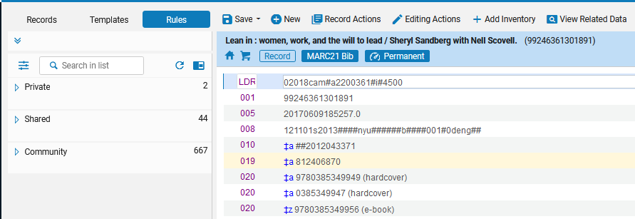
Accessing the rules
In the top left there are three tabs: “Records”, “rules”, and “Rules”. We will choose “Rules”.
Accessing rules

Slide 7
Accessing the rules
Get access to the three Rules ‘sub menus’ with indication as to how many rules there are in each sub menu.
Accessing rules

Slide 8
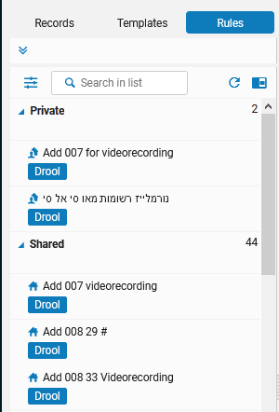
Accessing the rules
Note that multiple submenus can be opened simultaneously. Here both the “Private” and “Shared” submenus are open.
Icon specifying it is a private rule
More about the icons later.
Icon specifying it is a shared rule

Slide 9
Grouping of rules by rule type

Slide 10
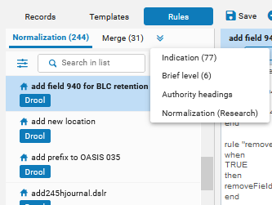
Grouping of rules by rule type
Here it is possible to choose which kinds of rules to deal with

Slide 11
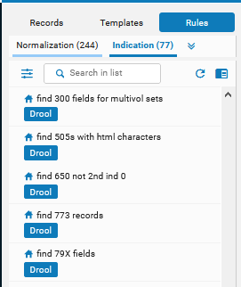
Grouping of rules by rule type
These are the indication rules. “Indication” appears in highlighted blue.

Slide 12
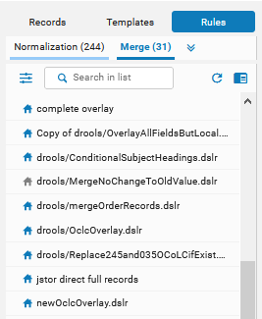
Grouping of rules by rule type
These are the merge rules. “Merge” appears in highlighted blue.

Slide 13
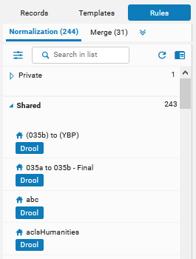
Grouping of rules by rule type
These are the normalization rules. “Normalization” appears in highlighted blue.

Slide 14
Managing rules

Slide 15
Managing rules
The shared user-created rules have a blue icon next to them
The private rules have an icon of a person next to them
The rules contributed by the community have an icon of people next to them

Slide 16
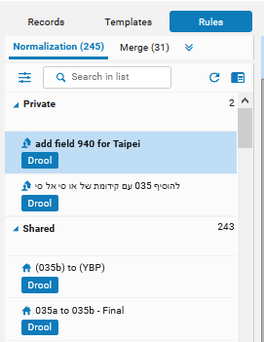
Managing rules
Private rules (created by the logged in user)
Shared rules

Slide 17
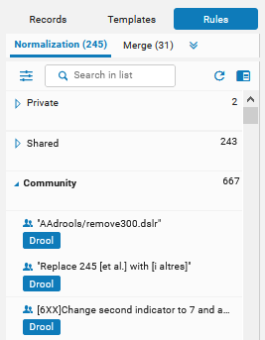
Managing rules
Rules contributed by the community.

Slide 18
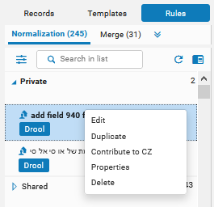
Managing rules
Actions can be taken on the rules via a right-click on the rule.
The private rules have the following action options: Edit, Duplicate, Contribute to CZ, Properties (which can be edited) and delete.

Slide 19
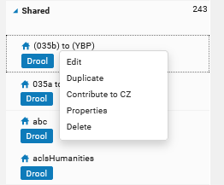
Managing rules
The shared rules, like the private rules have the following action options: Edit, Duplicate, Contribute to CZ, Properties (which can be edited) and delete.

Slide 20
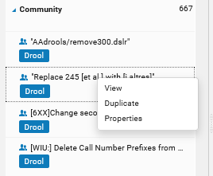
Managing rules
The community private rules have the following action options: View, Duplicate and Properties (which cannot be edited).

Slide 21
Editing rules

Slide 22
Editing rules
There are two ways to edit a rule:
Left-click the rule
Right click the rule and choose “edit”

Slide 23
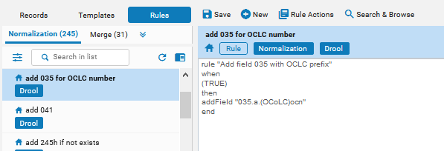
Editing rules
Here we have done left-click on “add 035 for OCLC number” and it moved to the top of the list and the rule opened in edit mode.

Slide 24
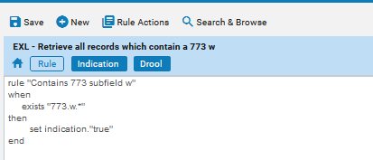
Editing rules
The rule header has the following indications:
  Name of rule
  That it was created by the institution (here it is the blue ‘house’ icon meaning it created by the institution, and it is not from the “Community” folder)
  The fact that it is a rule
  The type of rule (In this case an indication rule of type drool)

Slide 25
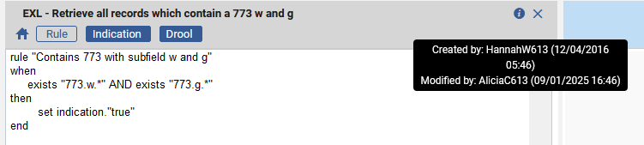
Editing rules
The “information” icon includes
  When it was created and by whom
  When it was modified and by whom

Slide 26
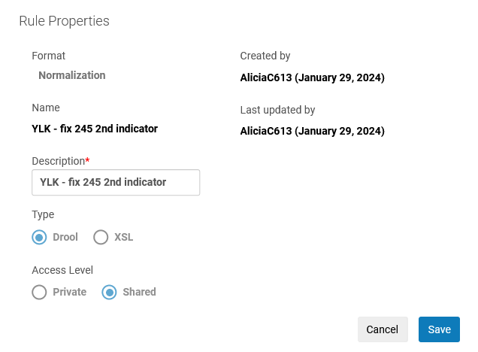
Editing rules
Note that when adding a new rule a radio button field for ‘Type” appears in the “New Rule” or “Properties” window (for existing rule). Here it is for a normalization rule:
A logical name and description to later know what this rule does
Choose shared if you want other uses to also access this rule
When creating a normalization rule for a MARC record 'Drool' is used. When creating a normalization rule for a DC (Dublin Core) record 'XSL' is used.

Slide 27
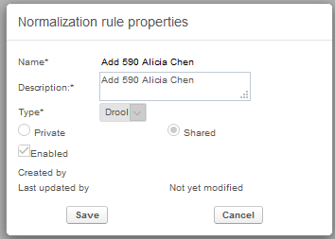
Editing rules
When editing an existing type, the “Normalization Rule Properties” window includes the type, but it is not editable.

Slide 28
Searching for and filtering rules

Slide 29
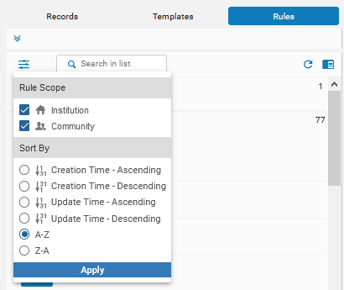
Searching for and filtering rules
The scope of the rules can be changed, for example to include only rules from the institution, only rules from the community, or both.

Slide 30
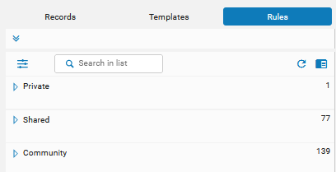
Searching for and filtering rules
By default, we see scopes “Institution” and “Community”

Slide 31
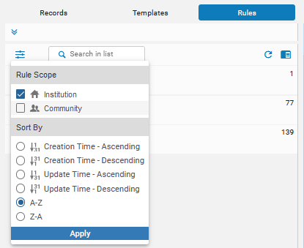
Searching for and filtering rules
Now we define to only see “Institution”

Slide 32
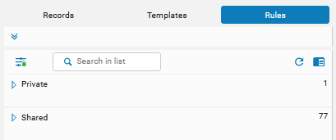
Searching for and filtering rules
Now we see the Institution folder and not the community folder.
This will also affect search results when searching for a rule. The search results will not include rules from the community.

Slide 33
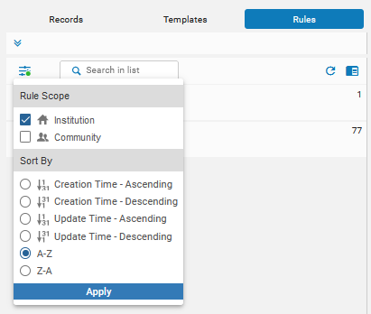
Searching for and filtering rules
The sorting of the rules can be changed, for example by creation time, update time, or name. The sort can be ascending or descending

Slide 34
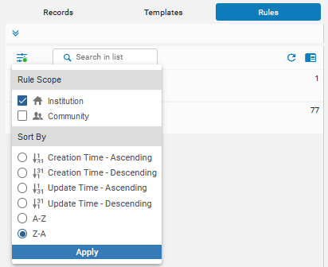
Searching for and filtering rules
Here we will sort by Z-A (alphabetical descending) for the scope of the institution

Slide 35
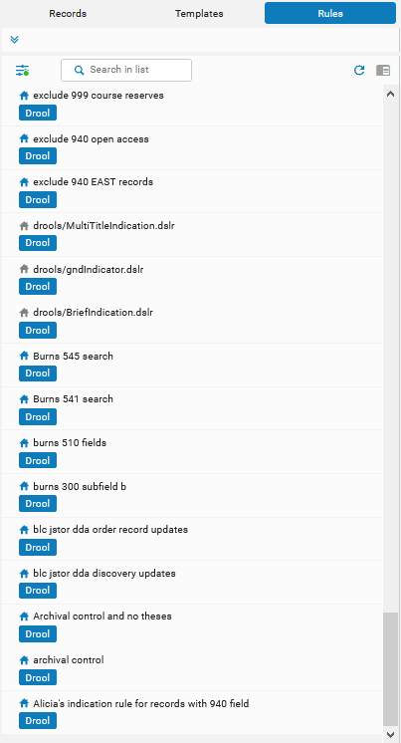
Searching for and filtering rules
The rule beginning with A, “Alicia's indication rule for records with 940 field” is at the bottom of the list.

Slide 36
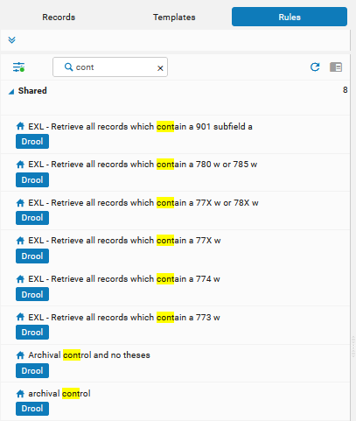
Searching for and filtering rules
It is possible to search for rules according a string in the rule name.

Slide 37
Testing rules

Slide 38
Testing Rules
In order to see this functionality “up close” let’s access and test a normalization rule in the metadata editor.
Note the we are focusing here on how to manage rules in the new metadata editor, and not the syntax of the rules.
On the next slide bibliographic record with title “The academic library development and administration in Taiwan / [edited by] Lian Ruan, Qiang Zhu, Ying Ye with introductory essay by Alicia Chen” is open in the metadata editor and we will switch to split editor mode

Slide 39
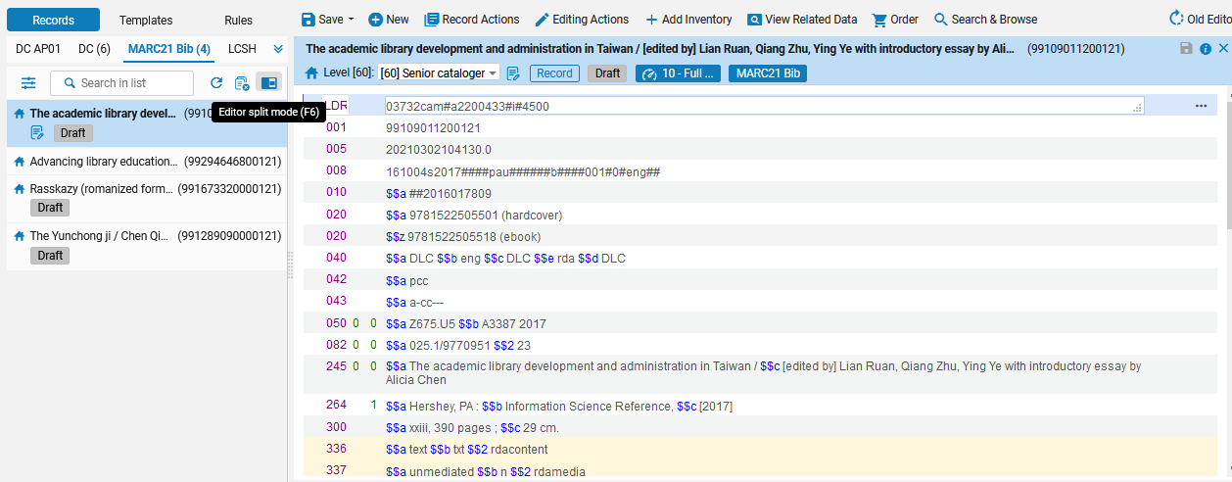
Testing Rules
Switch to split editor mode

Slide 40
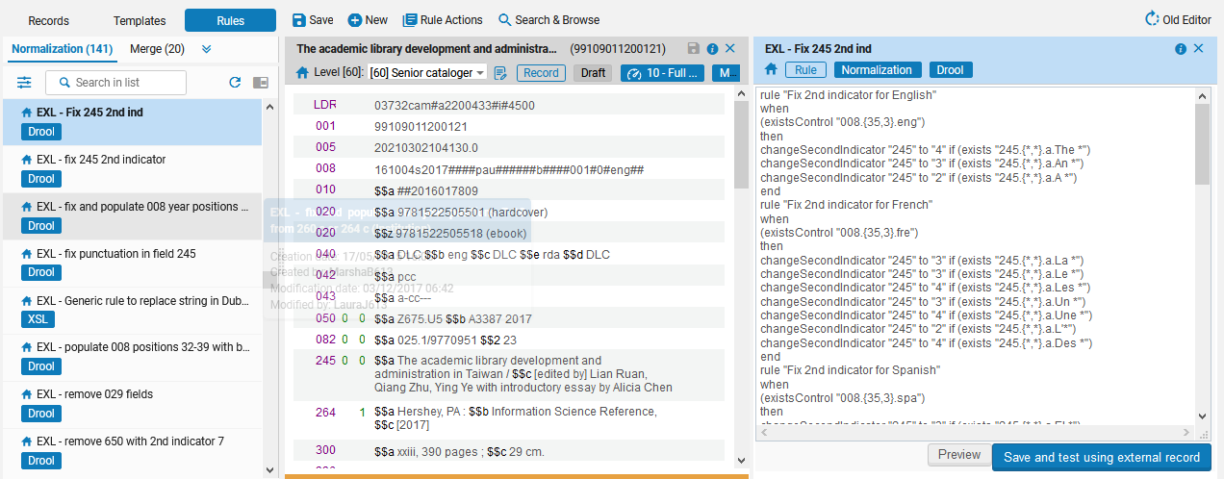
Testing Rules
In split editor mode put focus on right pane and left click the desired rule
We left-clicked the rule
The rule opened in the right pane

Slide 41
Testing Rules
Now we will test the rule by clicking “Preview”

Slide 42
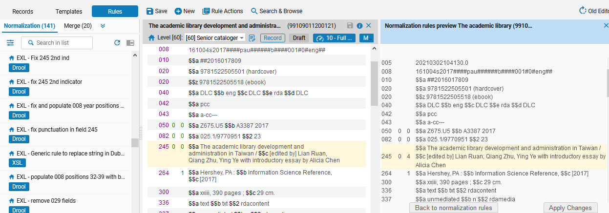
Testing Rules
We can compare the two records and see that the rule worked as desired
The 245 2nd indicator changed as desired

